Slide 1
Numerically Solving for Bessel Functions of the First Kind
Tobias Timofeyev

Slide 2
Overview
The Goal
Motivation
The Problem
The main idea
Cases and Results

Slide 3
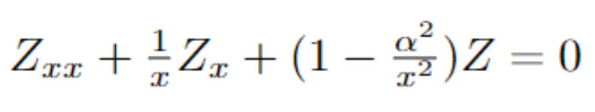
The Goal
We’d like to solve the following ODE on 0≦x<∞
This equation is called Bessel’s Equation, and its’ solutions are called Bessel functions.

Slide 4
Motivation
Laplace equation in cylindrical coordinates
Represents interaction of two spatial dimension in other pdes
Heat equation on a disk
Wave equation on a disk
In figure: radial part

Slide 5
The Problem
The ODE has a Singular Point at x=0
Can physically reason existence of nonsingular solution
Heat equation on disk can’t have infinite temperature at zero
These are called Bessel Functions of the First Kind.
One corresponding to every alpha.
Alphas are usually determined to be positive integers.
These are the solutions we’re looking for.
Bessel Functions of the Second Kind are the alternative solutions that have singularities at zero (like the equation).

Slide 6
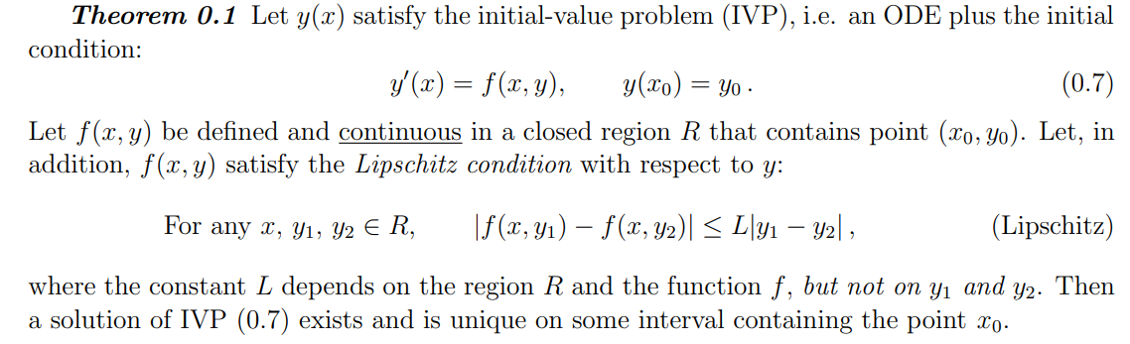
The Problem
Theorem 0.1 Requires a continuous ODE equation in order for existence and uniqueness to be guaranteed
only stated for first order, but it’s the same for a second order system
Bessel equation fails

Slide 7
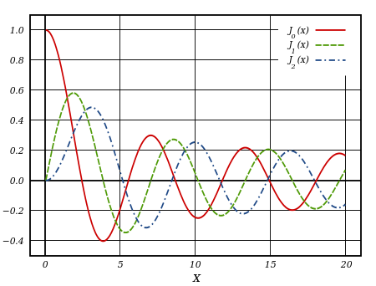
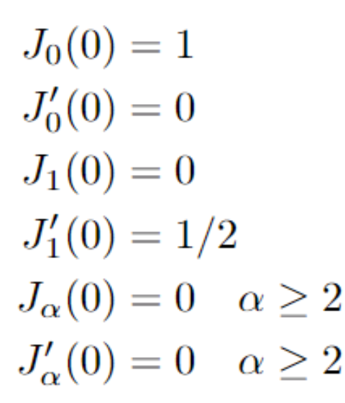
The Problem
Using prior knowledge of some boundary conditions
Starting IVP by assuming finite BC forces it to be nonsingular solution
Our boundary conditions:
Bessel Functions of the First Kind alpha=0,1,2

Slide 8
The Problem
We now have almost everything needed to to solve our IVPs
There’s still one obstacle: The ODE isn’t defined at the origin
We need a way of stepping away from the origin so that we can proceed with our usual IVP solution techniques (cRK)
Solution: Assume nonsingular solution exists and use its taylor expansion with boundary conditions and PDE to step away

Slide 9
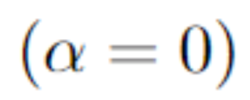
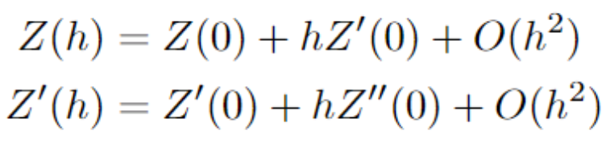
Method
Assume we want O(h^2) error, then we try to get that error at first step
We saw that in similar situations it would propagate and not grow
Thus we make the following approximations
We have Z(0) and Z’(0) from boundary conditions, but we need Z’’(0)

Slide 10
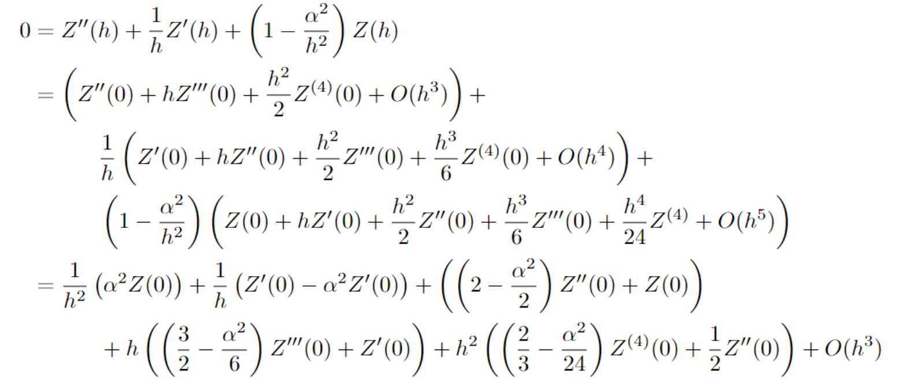
Finding 2nd Derivative
For equality to hold each term needs to be zero independently

Slide 11
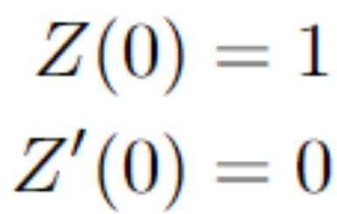
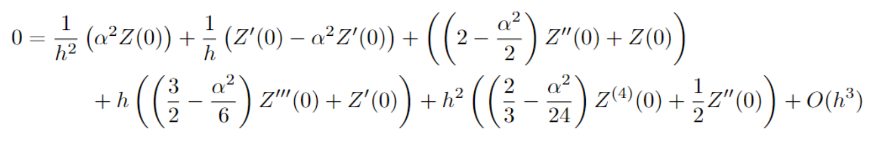
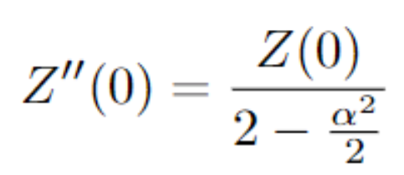
Case
The red terms confirm that our boundary conditions (chosen from convention) are valid (plugging BCs in confirms coefficients are zero)
The green term gives us a relationship for Z’’(0)

Slide 12
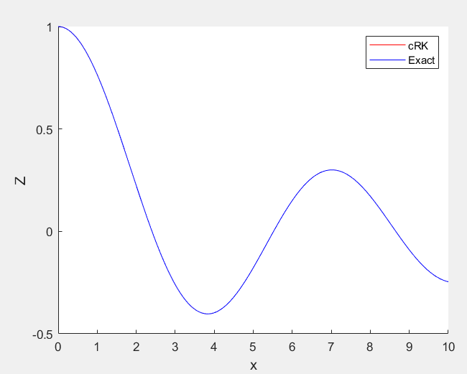
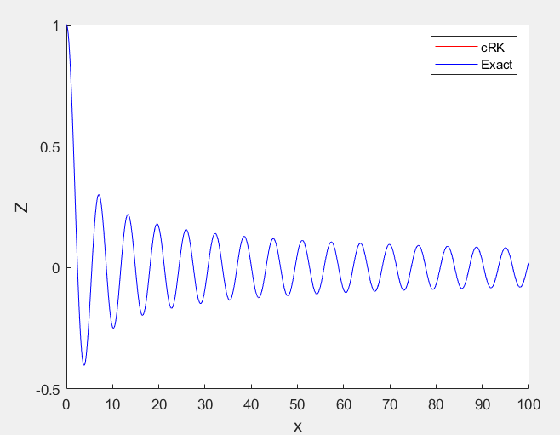
Result
If we step away using Z(0)=1,Z’(0)=0, and Z’’(0)=Z(0)/2 With

Slide 13
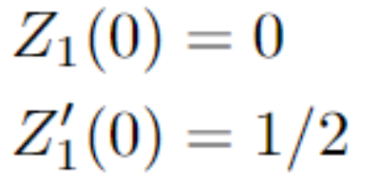
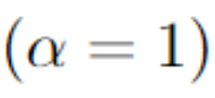
Case
The red terms confirm that our boundary conditions (chosen from convention) are valid for alpha=1
The green term gives us the same relationship for Z’’(0) as before

Slide 14
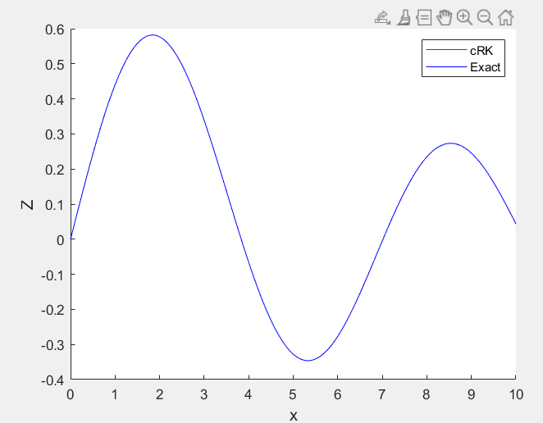
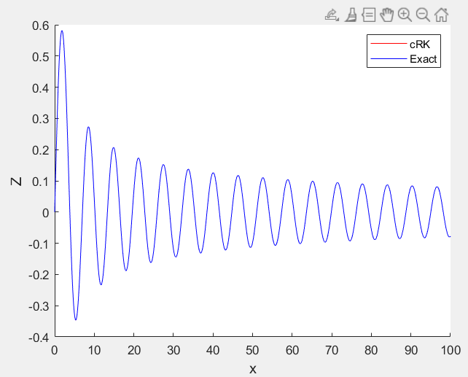
Result
If we step away using Z(0)=0,Z’(0)=1/2, and Z’’(0)=0 With

Slide 15
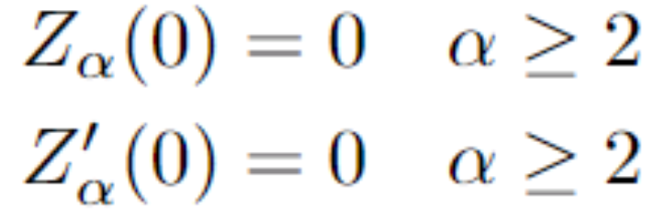
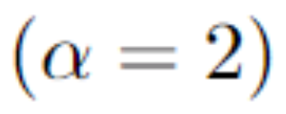
Case
The red terms confirm that our boundary conditions (chosen from convention) are valid for alpha=2
Problem: The value of alpha does not permit an equation for Z’’(0), causing it to be ‘free’.

Slide 16
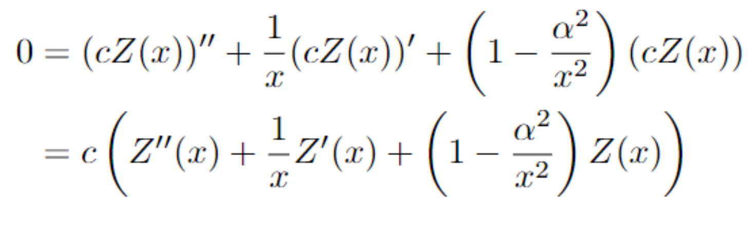
Bessel Equation Property
Solutions scaled by constants are also solutions
This means if we pick a value for Z’’(0), we’ll get a correct solution, though the scale might not match convention

Slide 17
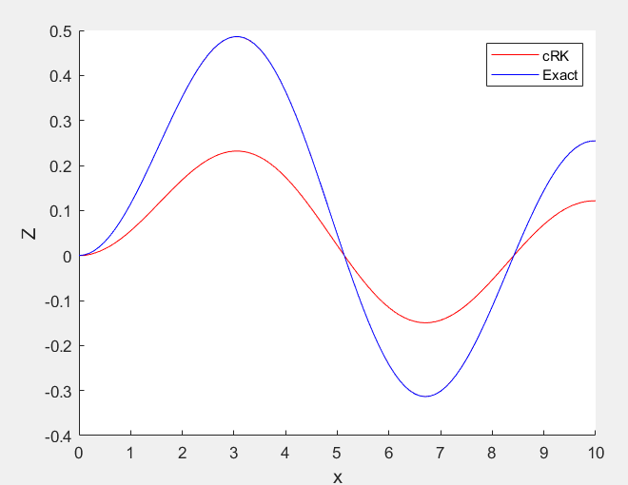
Scaled Solution for

Slide 18
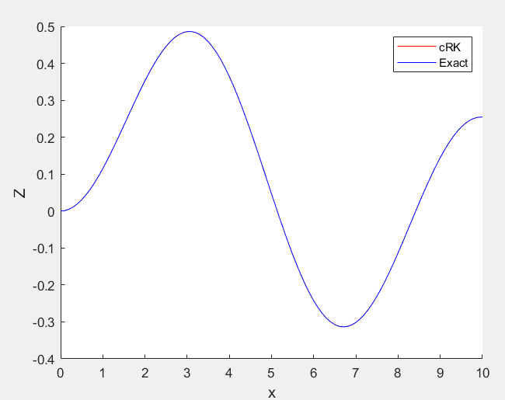
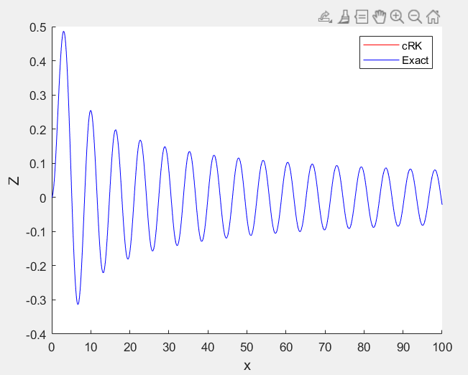
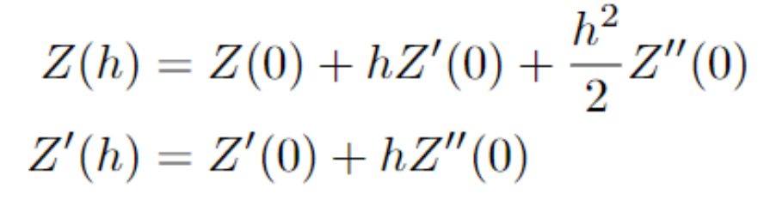
Result
Interestingly, to match the convention, need position to be third order accurate
If we step away using Z(0)=0,Z’(0)=0, and Z’’(0)=0.25 With

Slide 19
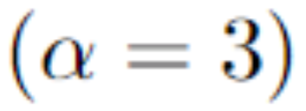
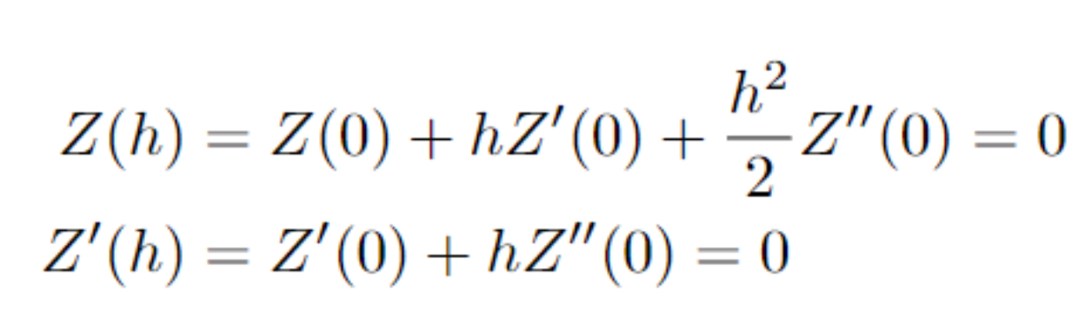
Case
The red terms confirm that our boundary conditions (chosen from convention) are valid for alpha=3
The green term gives us that Z’’(0)=0
This means that

Slide 20
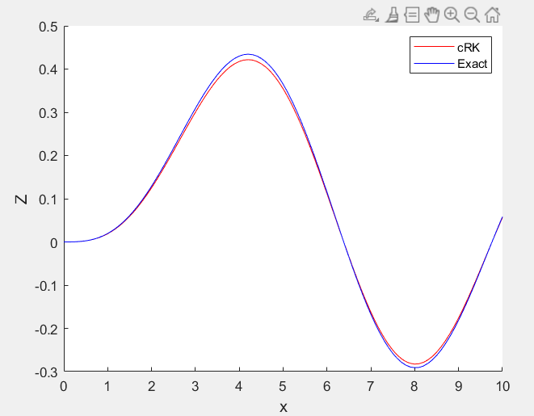
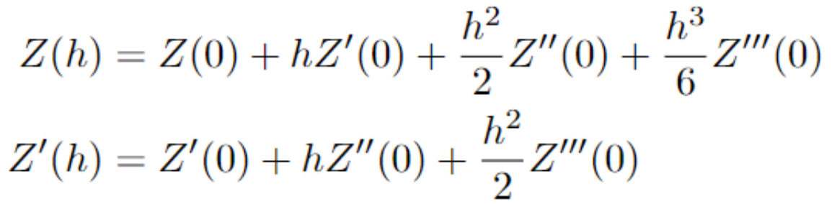
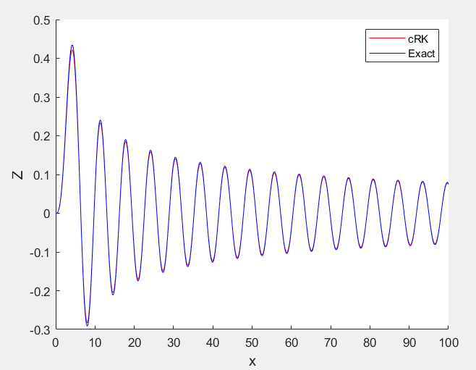
Result
If we step away using Z(0)=0,Z’(0)=0, and Z’’(0)=0, and Z’’’(0)=1/8 With
Notice that this doesn’t quite match the exact solution.

